Slide 1

GOVERNMENT ART AND SCIENCE COLLEGE AURANGABAD
DEPARTMENT OF HOME SCIENCE
RESEARCH METHODS & STATISTICS
PRESENTED BY:
Ku. Sheela B Janjal
M. A - 1 yr (sem I)
Research Methods & Statistics (Sessional)
DIABETES MELLITUS (DM)

Slide 2
CONTENT
INTRODUCTION
TYPES OF DIABETES MELLITUS
RISK FACTOR
DIABETIC COMPLICATION
FOODS THAT LOWER BLOOD SUGAR

Slide 3


INTRODUCTION
DIABETES MELLITUS(DM):
It is commonly referred to as diabetes, is a group of metabolic diseases in which there are high blood sugar levels over a prolonged period. Diabetes is due to either the pancreas not producing enough insulin or the cells of the body not responding properly to the insulin produced.

Slide 4
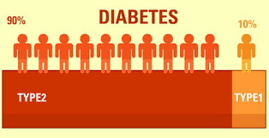
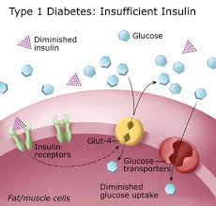
Types of diabetes mellitus:
1)Type 1 DM- In this type pancreas's failure to produce enough insulin.
This referred as "insulin-dependent diabetes mellitus" (IDDM) or "juvenile diabetes".
The cause is unknown.

Slide 5
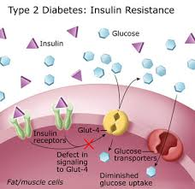
2)Type 2 DM- In this type cells fail to respond to insulin properly.
As the disease progresses a lack of insulin may develop.
This referred as "non insulin-dependent diabetes mellitus" (NIDDM) or "adult-onset diabetes".
The primary cause is excessive body weight and not enough exercise.

Slide 6

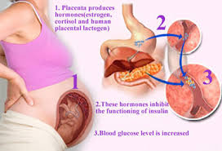
3)Gestational diabetes- This occurs when pregnant women without a previous history of diabetes develop high blood-sugar levels.

Slide 7


Slide 8
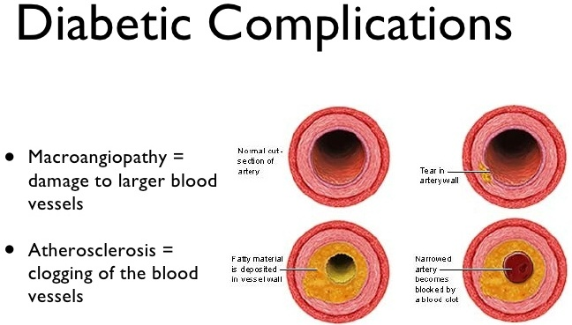
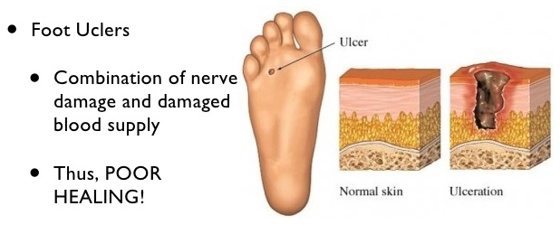

Slide 9
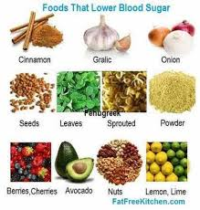

Slide 10
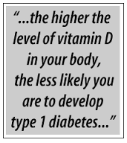




Slide 11
THANK YOU

